Slide 1
Civil Works Training

Slide 2
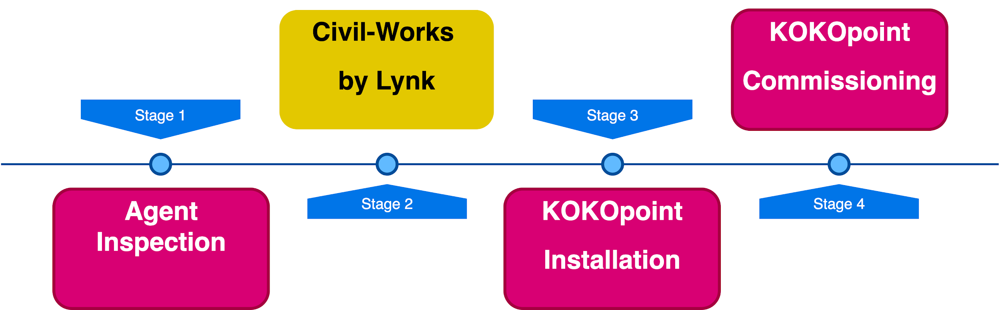
Process Overview

Slide 3





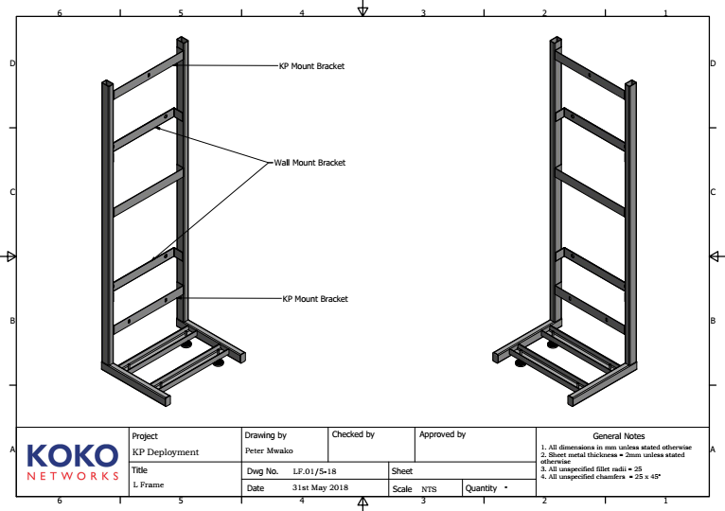
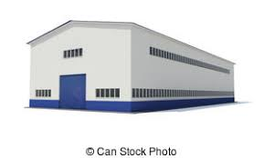

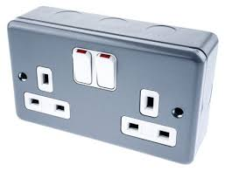
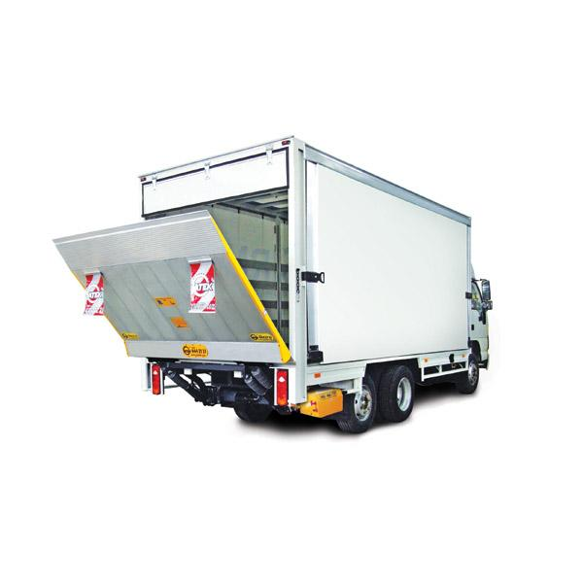


Civil Works Schedule(Doc)
Tools
Human Resource
CIVIL WORKS
Logistics
Material
‹#›

Slide 4
Civil works Process

Slide 5

THANK YOU

Slide 6
y.koech@kokonetworks.com

